Slide 1

Chapter 2 Part 3
Data Models
The slides in this presentation have been adapted from slides provided with the textbook, Database Systems: Design, Implementation, and Management,
12E, Cornel and Morris, Copyright © 2017 Cengage Learning.

Slide 2
Learning Objectives
About emerging alternative (big) data models and the need they fulfill
How data models can be classified by their level of abstraction
Copyright © 2017 Cengage Learning
2

Slide 3
Big Data
Aims to:
Find new and better ways to manage large amounts of web and sensor-generated data
Provide high performance and scalability at a reasonable cost
Characteristics
Volume
Velocity
Variety
Veracity
Copyright © 2017 Cengage Learning
3

Slide 4
Big Data Challenges
Volume does not allow the usage of conventional structures
Expensive
OLAP tools proved inconsistent dealing with unstructured data
Copyright © 2017 Cengage Learning
4

Slide 5
Big Data New Technologies
Hadoop
Hadoop Distributed File System (HDFS)
MapReduce
NoSQL
Copyright © 2017 Cengage Learning
5

Slide 6
NoSQL Databases
Not based on the relational model
Support distributed database architectures
Provide high scalability, high availability, and fault tolerance
Support large amounts of sparse data
Geared toward performance rather than transaction consistency
Store data in key-value pairs
Copyright © 2017 Cengage Learning
6

Slide 7
NoSQL
Advantages
Disadvantages
High scalability, availability, and fault tolerance are provided
Uses low-cost commodity hardware
Supports Big Data
Key-value model improves storage efficiency
Complex programming is required
There is no relationship support
There is no transaction integrity support
In terms of data consistency, it provides an eventually consistent model
Copyright © 2017 Cengage Learning
7

Slide 8
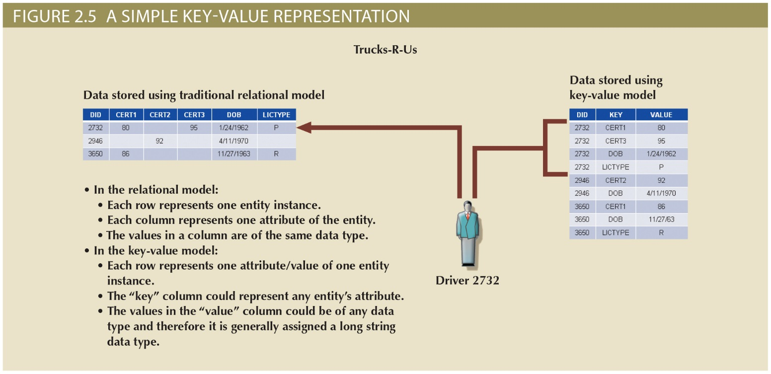
Figure 2.5 - A Simple Key-value Representation
Copyright © 2017 Cengage Learning
8

Slide 9
Task 1
In figure 2.5: Why is there only one row in the relational model for employee 2732, but four rows in the key-value representation for this employee? ___________________________________
What MIT class should you take to learn more about big data?
ACIS5524 Advanced DB Management Systems is a survey of technologies including assignments for XML, NOSQL, and Hadoop.
Others exist check them out.
Copyright © 2017 Cengage Learning
9

Slide 10
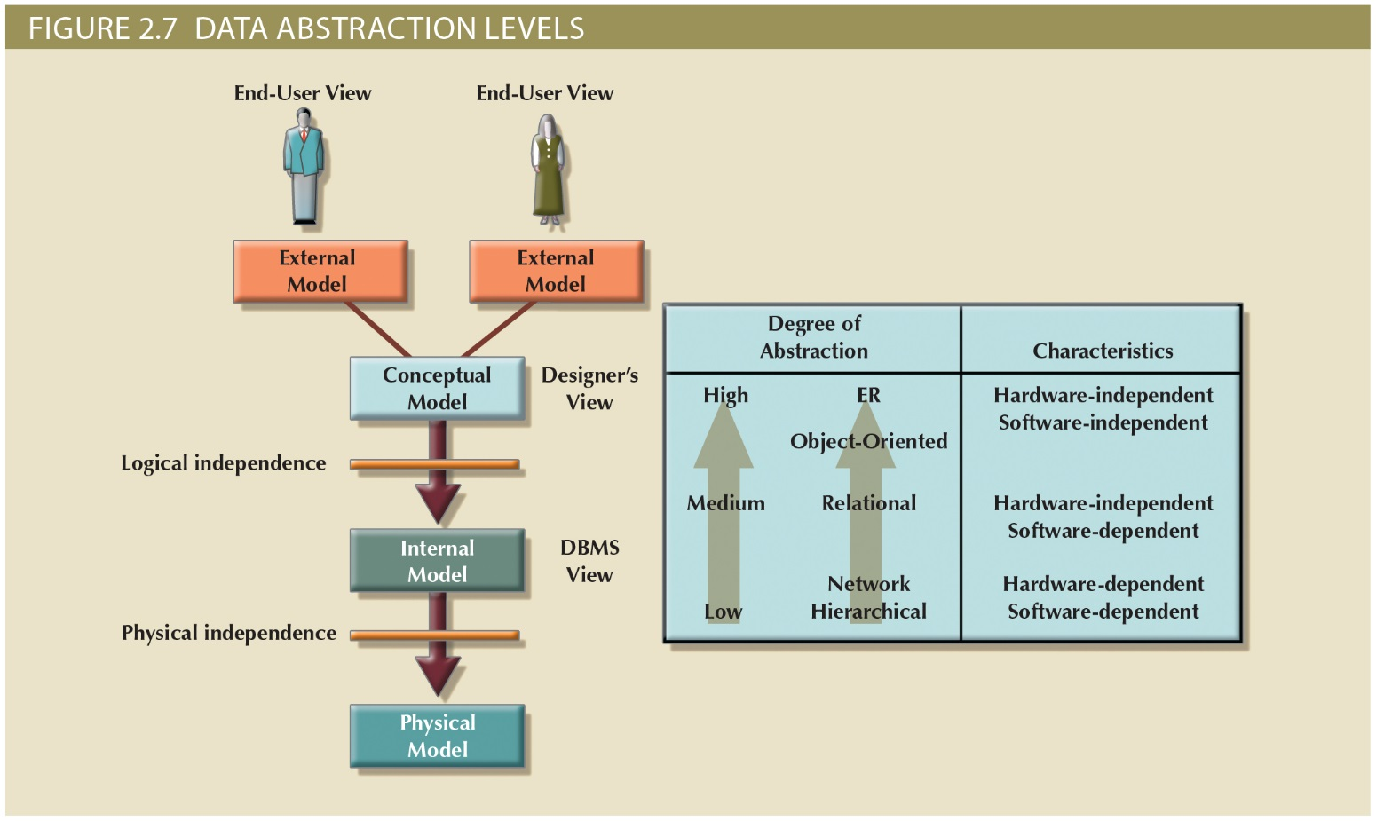
Data Abstraction Levels
Copyright © 2017 Cengage Learning
10

Slide 11
The External Model
Simplifies to focus on specific data required to support each business unit’s operations
End users’ view of the data environment
ER diagrams represent external views
External schema: specific representation of an external view
Entities
Relationships
Processes
Constraints
Copyright © 2017 Cengage Learning
11

Slide 12
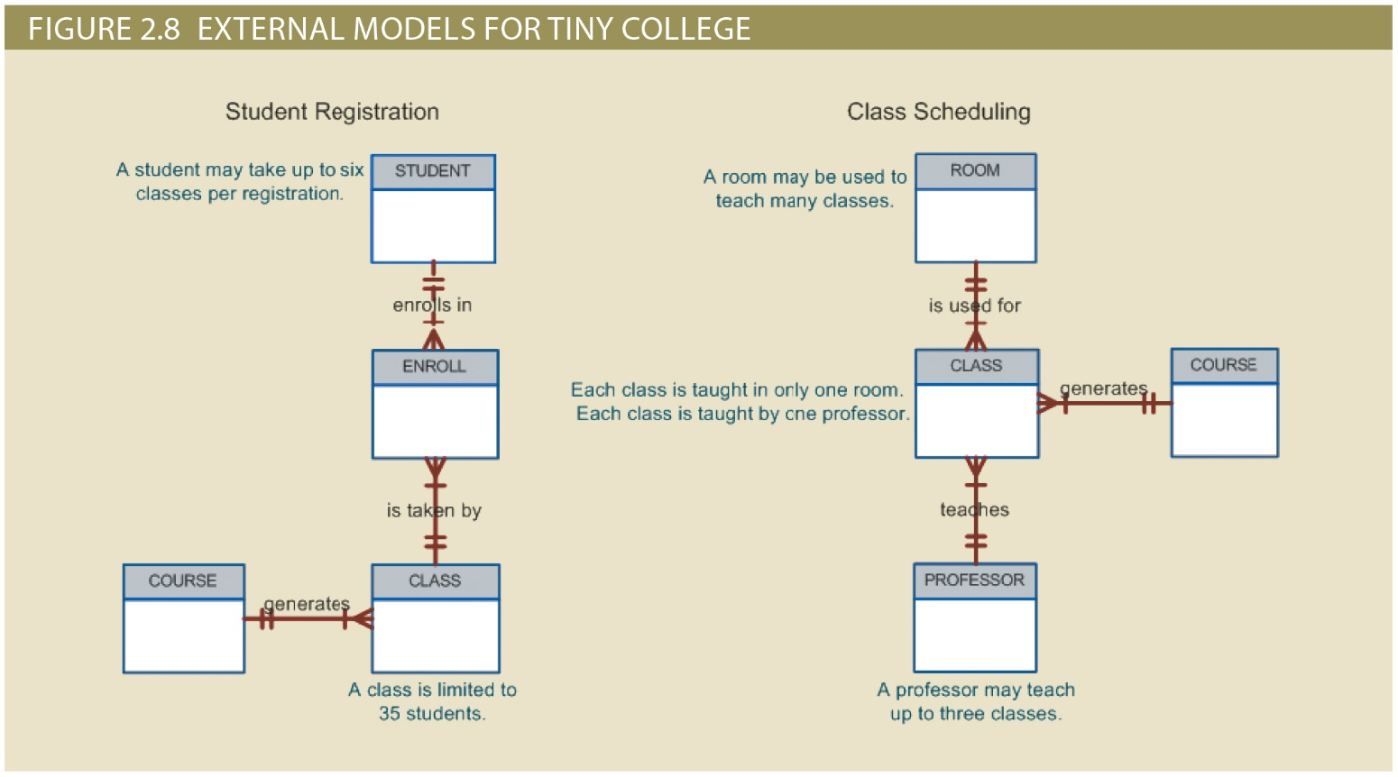
Figure 2.8 - External Models for Tiny College
Copyright © 2017 Cengage Learning
12

Slide 13
The Conceptual Model
Represents a global view of the entire database by the entire organization
Conceptual schema: Basis for the identification and high-level description of the main data objects
Has a macro-level view of data environment
Is software and hardware independent
Logical design: Task of creating a conceptual data model
ERD graphically represents schema
Copyright © 2017 Cengage Learning
13

Slide 14
The Internal Model
Representing database as seen by the DBMS mapping conceptual model to the DBMS
Internal schema: Specific representation of an internal model
Uses the database constructs supported by the chosen database
Is software dependent and hardware independent
Logical independence: Changing internal model without affecting the conceptual model
Copyright © 2017 Cengage Learning
14

Slide 15
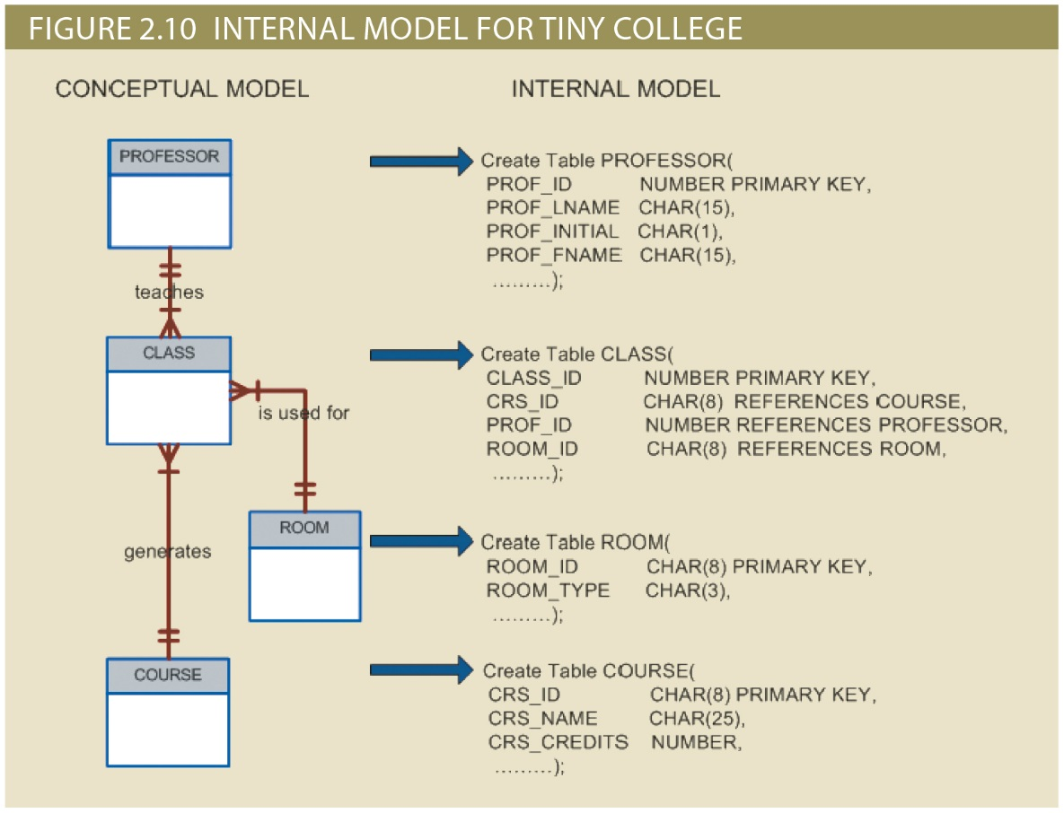
Figure 2.10 - Internal Model for Tiny College
Copyright © 2017 Cengage Learning
15

Slide 16
The Physical Model
Operates at lowest level of abstraction
Describes the way data are saved on storage media such as disks or tapes
Requires the definition of physical storage and data access methods
Relational model aimed at logical level
Does not require physical-level details
Physical independence: Changes in physical model do not affect internal model
Controlled by the DBMS, e.g., Oracle, SQL Server
Copyright © 2017 Cengage Learning
16

Slide 17
Summary
Data-modeling requirements are a function of different data views and abstraction levels
Three abstraction levels: external, conceptual, and internal
Big Data deals with distributed and mostly unstructured data
Copyright © 2017 Cengage Learning
17

Slide 18
Task 2
Which level of abstraction is the easiest for users to understand: ___________________________________
The physical level is under the control of which of these programs:
DBMS
Web Server
Other
Copyright © 2017 Cengage Learning
18

